Slide 1
Islam

Slide 2
Allah
The Arabic word for God and how Muslims refer to their God

Slide 3
Muslim
A follower of the religion on Islam

Slide 4
Prophet
‘A person regarded as an inspired teacher of the will of God’

Slide 5
Muhammad
Revealed Islam over 1400 years ago and is the last prophet sent by Allah
It is believed that Muhammad wrote the Qur’an as dictated by Allah

Slide 6
Qur'an
The Holy Book of Islam

Slide 7
5 Basic Pillars of Islam
The declaration of faith
Praying 5 times a day
Giving money to charity
Fasting
A pilgrimage to Makkah at least once in a lifetime

Slide 8
The Five Pillars of Islam

Slide 9

What are they?
The Five Pillars of Islam are the duties that support the whole way of life for a Muslim.
Practising the Five Pillars is a way of obeying Allah.
The Pillars help Muslims to realise their true self and become the kind of humans that Allah wants them to be.
Only true if the rituals of the Five Pillars are performed with sincerity and the right intention.
No matter how sincerely a person may believe, Islam regards it as pointless to live life without putting that faith into action and practice.

Slide 10
First Pillar: The Shahadah
The first pillar is a statement of belief in one God, which underpins everything else that a Muslim does.
Recognises that Allah is more important than anything else, and that Muhammad was his final messenger.
The Shahadah is said as often as possible.
A Muslim must be prepared to turn his or her whole life towards Allah.
Notes:
Muslims express their intention to follow the path and example of the Prophet as closely as possible.

Slide 11
Second Pillar: Salah
The Qur’an says: ‘Preserve prayer and especially the middle prayer (2:238).
Prayer in this sense refers to salah, five set prayers that must be said daily.
Face Mekkah while praying.
These are:
Fajr
Zuhr
Asr
Maghrib
Isha
Wudu:
To make sure the intention is right, a person must prepare properly and perform acts of purification.
Wudu symbolises the cleansing of the body on the inside – a vital theme in Islamic worship.
Notes:
Prayer –
Just before sunrise
Just after midday
In the afternoon
Just after sunset
During night before midnight
Wudu:
Parts of the body are washed in a particular way.
Hands are washed three times – Ask Allah to cleanse them of their sins.
Nostrils are washed 3 times – Prays that they may be pure enough to smell the sweetness of Paradise.
Face washed 3 times – Displays light of Allah
Both arms washed
Palm of hand passed over head
Ears
Feet – Right for righteousness and the left in the hope that the person may be saved from sin.

Slide 12
Third Pillar: Zakah
Giving money to the poor.
Very often this is paid at the end of Ramadan.
Recognises that all good things are a gift from Allah.
Teaches Muslims to support people in need – All have a duty to give and receive it.
They contribute 2.5 per cent of their savings to zakah.
Money is often sent to developing countries such as Bangladesh or India.
Notes:
RAMADAN = TIME OF WORSHIP AND CONTEMPLATION e.g. fasting
Zakah benefits the giver by removing greed and selfishness.

Slide 13
Fourth Pillar: Sawm
Fasting.
Reflects the periods of time when Muhammad went away to meditate.
Duty of adult Muslims to fast during the daylight hours of the month of Ramadan.
Fasting is both internal and external – No food or drink between dawn and sunset.
Fasting helps Muslims to become more aware of the Creator and the duties he expects from them.
Notes:
The fast is broken each day at sunset with a light meal – glass of water and some dates.
Also helps them to identify with those who suffer hunger and thirst in the world.
Fasting also helps Muslims to learn to control their physical desires, rather than be controlled by them.

Slide 14
Fifth Pillar: Hajj
Hajj is a mass pilgrimage to Makkah that takes place once a year.
All Muslims must make the pilgrimage at least once in their lifetime if they are able.
Takes 5 or 6 days.
Happens in the 12th month of the Islamic calendar.
Men wear ihram – two pieces of white cloth.
Women can wear whatever is most comfortable – usually a long dress and head covering.
Notes:
However, not everyone manages this, because a pilgrim should be a responsible adult, fit enough to cope and afford the trip without leaving the family in debt.
Men white cloth symbolises purity and equality
Clothing means that no distinctions can be made between rich and poor – everyone is equal in the sight of Allah

Slide 15
Lesson Activities for pupils
Each child could create, in the style of the five pillars of Islam, their own picture containing 5 things that are important in their lives.
They could then write a few words about these things and draw some pictures to represent them.

Slide 16
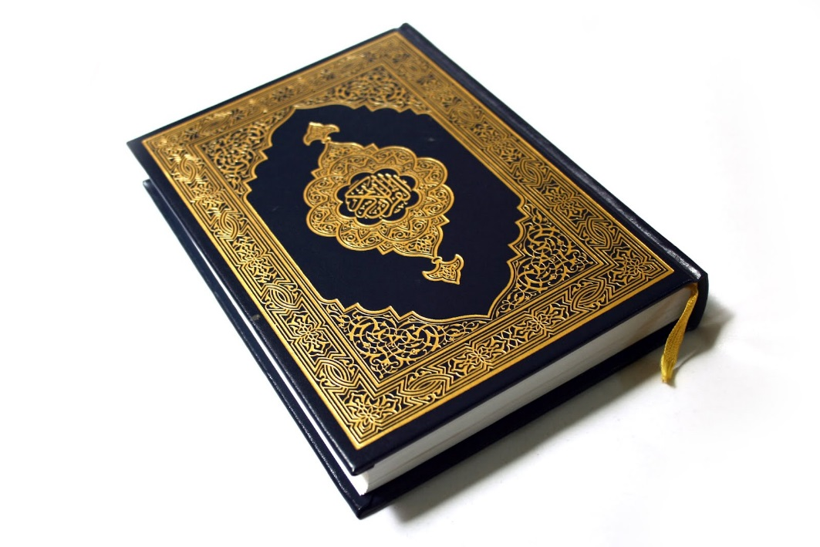
The Quran
What is the Quran?
What does the Quran say about day to day life?
How does the Quran relate to other religions?
http://www.bbc.co.uk/education/clips/z4fgkqt

Slide 17
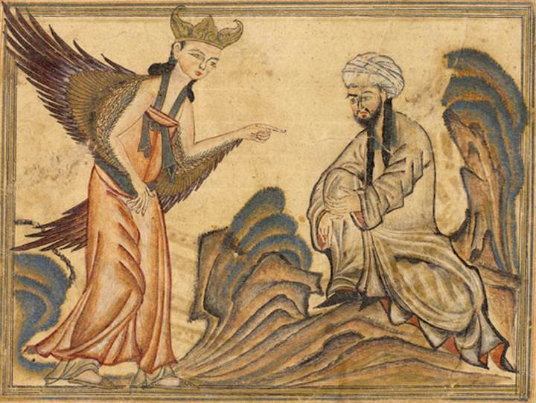
What is the Quran?
The holy scripture for Muslims
The Quran is written in Arabic and there is only one translation of it.
The book of Hadith is the second most important book in Islam – a collection of sayings and actions of Muhammad, this gives an example for Muslims of how to put the Quran into practice.
Some earliest copies of the Quran date back to the 7th and 8th Centuries.
Muslims believe that the Quran is God’s word, spoken through the angel Gabriel to Muhammad.

Slide 18
How does the writing in the Quran relate to other religions?
Jesus was a real person
Muslims
Christians
Jesus was the son of God
Muslims
Christians
Jesus was born of a virgin
Muslims
Christians
Jesus will come again
Muslims
Christians
Muslims believe that Jesus was a prophet. His name is in the Quran 25 times – more times than Muhammad's!

Slide 19
What does the Quran say about day-to-day life?
Men should not wear
figure-hugging clothes.
Neither men nor women should wear gold or silver.
Hijab – a rectangular piece of fabric that is folded over a woman’s head.
Khimar – a more general term for a veil covering a woman’s head or face
Abaya – a cloak that women wear in public, made of synthetic black fibre
Chador – a clock that is worn in public – unlike the abaya, the chador does not fasten at the front
Niqab – A veil worn over the face which may or may not leave the eyes covered.
Burqa – A type of veil, common in Afghanistan that coveres all parts of the body with a thin screen
Shalwar Kameez – Loose trousers worn by both men and women
Thobe – A long white robe worn by men
Women should cover their chest and figure when they go out.

